Slide 1

AUTOMATED ATTENDANCE TRACKING SYSTEM USING BLUETOOTH DEVICE IDENTIFICATION’
FEDERAL UNIVERSITY OF TECHNOLOGY MINNA, DEPARTMENT OF TELECOMMUNICATIONS ENGINEERING
Gabriel, Ushie Osise
2019/1/78786CM Supervised by Dr. STEPHEN OWYEWOBI
co-supervisor
Prof. ELIZABETH, N. ONWUKA
MARCH, 2025

Slide 2

Problem Statement
Current Attendance Methods Are Inefficient 📌 Manual roll calls → Slow, error-prone 📌 RFID & Biometrics → Expensive, need extra hardware 📌 Proxy attendance → Easy to cheat 📌 No real-time tracking → Delayed updates
We need a system that is: ✅ Automated ✅ Accurate & Secure ✅ Low-cost & Scalable ✅ Real-time Sync to Cloud

Slide 3




System Overview
Management Software
Database
Bluetooth Module
Key Components: ESP32 Microcontroller (Bluetooth scanning).
OLED Display & Buttons (For course selection & session start).
Mobile App (Student device detects ESP32 via Bluetooth).
Cloud Database (MongoDB/Firebase) (Real-time sync).

Slide 4
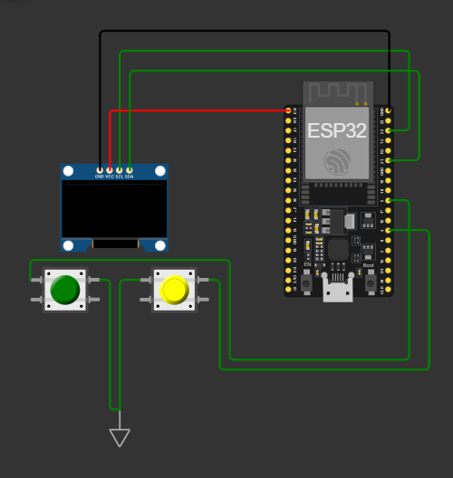
Circuit Diagram of Bluetooth Module

Slide 5
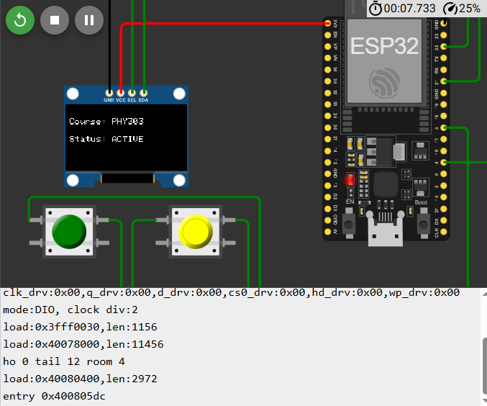
Simulation
Testing Environment:
Wokwi Simulation for ESP32 & OLED.
Arduino IDE for Bluetooth programming.
Screenshot of Simulation in Wokwi (ESP32 scanning Bluetooth devices).
Circuit Components & Cost (~₦35,000–₦50,000/unit)

Slide 6
Similar Works
📖 Azim et al. (2020): Bluetooth & RFID system, but expensive and hardware-dependent. 📖 Alrowaily (2022): BLE-based attendance, but requires manual broadcasting. Why This Solution is Better? ✅ Automated & Contactless ✅ Accurate & Secure (Session-based, encrypted communication) ✅ Real-Time Sync to Cloud ✅ Low-Cost & Scalable

Slide 7
Expected Outcomes & Benefits
Why This Solution is Better? ✅ Automated & Contactless ✅ Accurate & Secure (Session-based, encrypted communication) ✅ Real-Time Sync to Cloud ✅ Low-Cost & Scalable

Slide 8
Estimated Time Of Completion
Week | Task
Week 1-2 | Hardware setup, ESP32 configuration, and component testing.
Week 3-4 | Bluetooth scanning implementation and integration with OLED display.
Week 5-6 | Development of the mobile app for student check-ins.
Week 7-8 | Cloud backend setup, database integration, and real-time syncing.
Week 9-10 | System testing, debugging, and security improvements.
Week 11-12 | Final optimization, report documentation, and presentation preparation.

Slide 9
Conclusion
✅ The proposed system combines automation, security, cost-effectiveness, and real-time cloud sync, making it superior to existing methods!

Slide 10
THANK YOU

